Slide 1
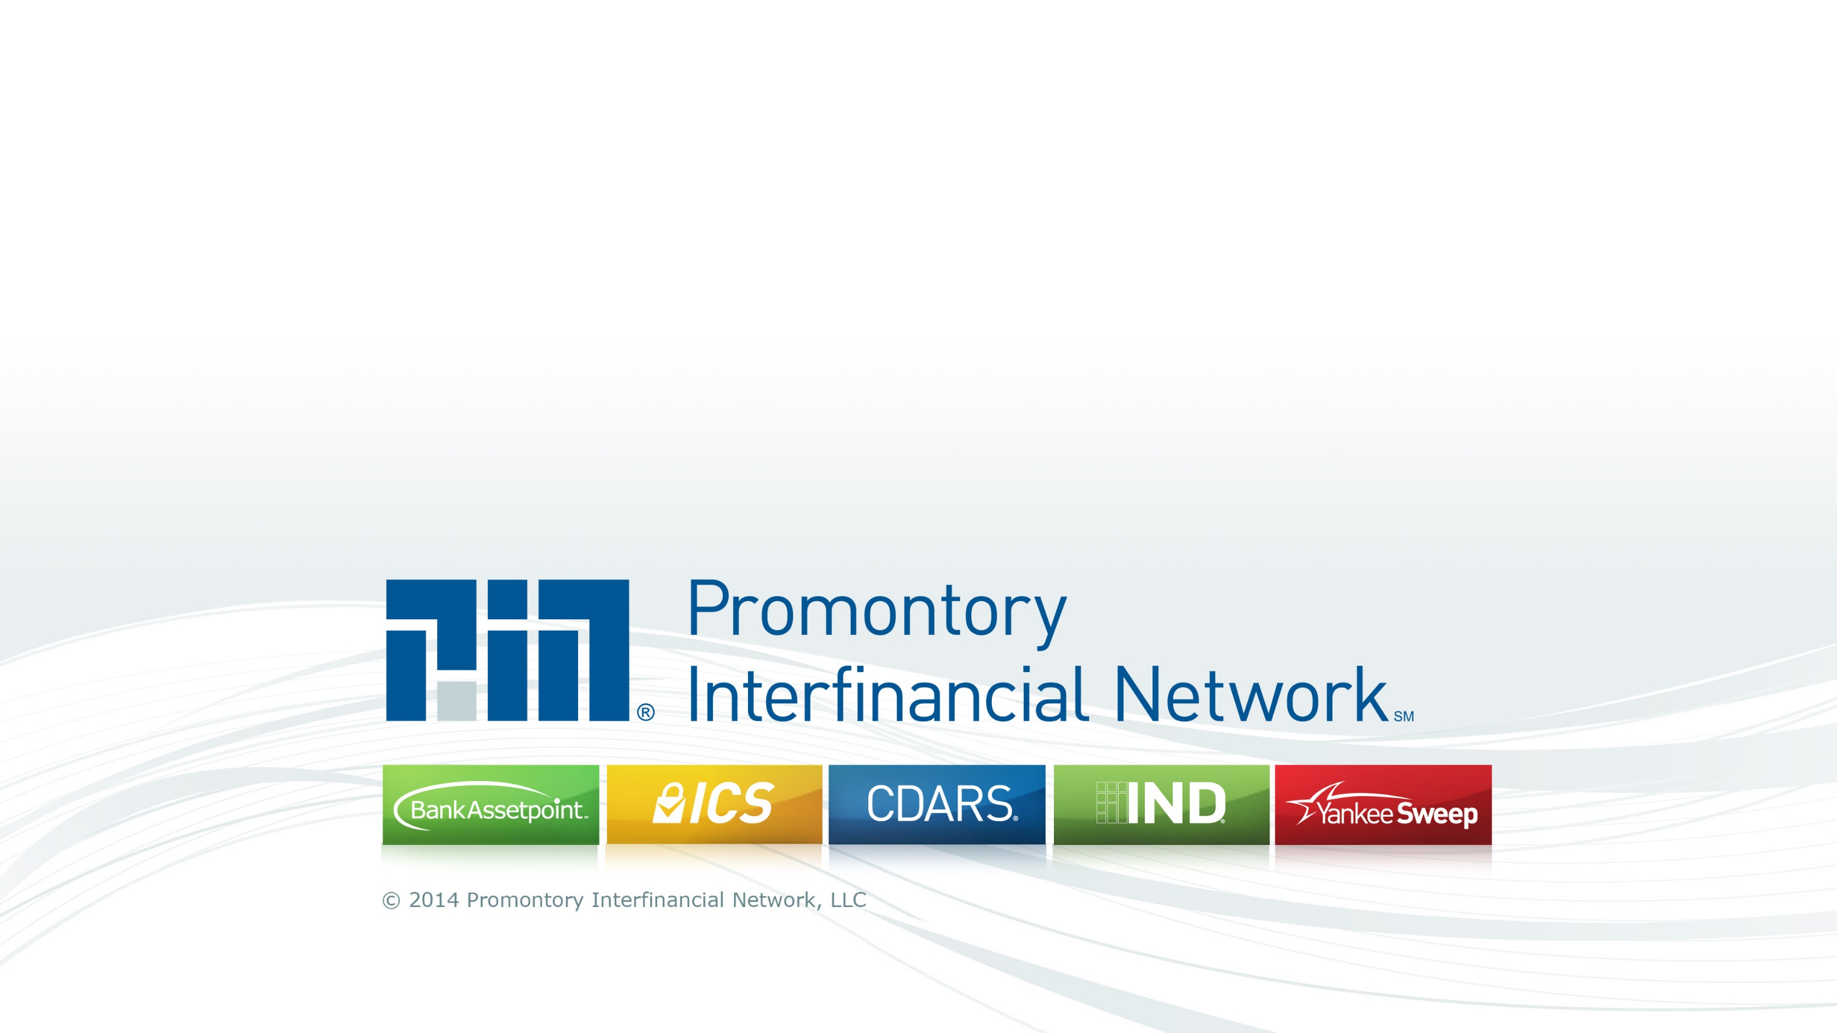
Positioning Agile and Continuous Delivery for Auditors and Examiners
Notes:
Turned the corner and have one product running in a CD environment, deployments every two weeks, BLUE GREEN, rebuilding infrastructure with any release if we want
3 deployments in 2012 to 25 in 2013….holding steady at a deployment every two weeks – 18 months to go from manual, waterfall to agile, CD
GOOD – Culture was not a problem – Argue whether CD/DevOps was Top Down or Bottom Up
BAD – We cannot dedicate resourced to create “A Team” to pave the road…share resources…we have to buy everything…can’t build our own tools
182 slides for last audit
85 slides with a lot of content for Gene Kim - Phoenix Project – Auditor Toolkit
50 slides for various meetups
36 slides for DevOps Conference!
----- Meeting Notes (10/21/14 19:39) -----
.

Slide 2
Credits
Operations Team
Brad Network Engineer
Karthik Senior Network Engineer
Richard Senior System Engineer
Thomas Senior System Engineer
Reji Senior Application Engineer, Architect
Aditya Application Engineer
Rajesh Senior Application Engineer
Charlie Database Administrator, Senior Architect
Dion Director of IT Architecture
Development Team
Fred Senior Java Developer, Senior Architect
Ahmed Senior Continuous Delivery Engineer
Geeta Quality Assurance Engineer
Bonita Business Analyst
Allan Database Developer
Jamil Business Analyst
Notes:
Great cross section of IT - Truly DevOps
Enlightening about the world of Operations

Slide 3
Where to Start
Have the right mindset
Look at audits and examinations as a challenge, not a burden
Understand that audits are in place for the benefit of consumers
Understand your auditor’s goals
Does this entity have a sound development practice?
Do they have repeatable processes that ensure consistent results?
Do you have the appropriate controls in place?
Does your management team understand the risk they are exposed to?
Notes:
IF IT IS HARD DO IT MORE OFTEN
Typically no one likes audits….they don’t feel it is their job….they feel it is getting in the way of the work they need to do
PUT Audits and Audit prep in Job Descriptions

Slide 4

Taking a Step Back…Let’s Start with the Bible
During an examination, the examiner explained that he wanted to see our “Bible”, aka our SDLC. He wanted every step to be documented and auditable so he could be sure that every project followed the exact process, every time.
Credit: http://www.stpatselkhorn.org/AdultFormation/BibleStudy.aspx
Notes:
RACI charts – MD102 – Department of Homeland Security
tractability matrices…
meeting invitations to be saved!
Review materials needed to be sent out prior to meetings
Result: Development came to a grinding halt.
– A second SDLC was written which stripped away 90% of the full SDLC rigor
Result: Every project became SDLC Lite.
Agile – We obviously blamed Waterfall for our shortcomings (it couldn’t be us). We went Agile….sort of.
Result: Chaos. Team was not ready for quick sprints, documentation wasn’t done, code wasn’t finished…..
Agile & Continuous Delivery – A proper implementation of Agile with the technical craftsmanship that is required.
Result: A successful and strong base in which to build

Slide 5
Tips and Techniques for Audits and Exams
1 - 6 : Common Sense & Agile Education
7 - 12 : Continuous Delivery Education
13 - 18 : Demonstrating Maturity
19 - 21 : Orchestrate for Improved Quality
22 - 24 : Source Code Control is KEY
25 : Getting Ahead

Slide 6

Common Sense & Agile Education
Credit: http://flickfacts.com/movie/4925/back-to-school

Slide 7
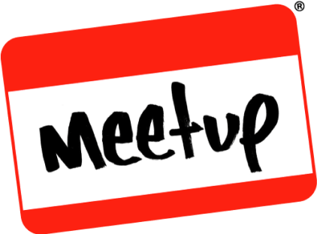
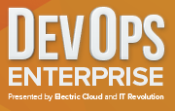
Common Sense & Agile Education
#1 Socialize Your Plans!
#2 Don’t Risk the Crown Jewels
#3 Demonstrate Your Expertise
Training Programs (Secure Coding, etc.)
Meetups & User Groups
Conferences (DevOps Enterprise!)
#4 Map Agile to Waterfall
#5 Explain Benefits of Shorter Cycle Time
#6 Explain How Small Batches Reduces Risk
Schedule risk
Feature creep
Gold plating
Quality risk
New bugs
Instability
Business risk
Wrong functionality
Missed opportunity
Notes:
#1 SOCIALIZE PLANS - Don’t surprise your auditor with a major change to your process.
Provide Useful Information:
Continuous Delivery: Rel by Jez Humble and David Farley
Phoenix Project by Gene Kim
#3 – ALSO HELPS GET A TRAINING BUDGET
#4 – NEW SLIDE

Slide 8
#4 Map Agile SDLC to Waterfall SDLC
Design | Waterfall | Agile
Design | The entire application is designed at one time | The design evolves as the application is developed
 | The design is created by technical resources working from the requirements | The design is created by the developers working with the key stakeholders
 | The design is based on the best estimate of how the application is used | The design is based on customer behavior
Design Review | The design is reviewed by technical resources to ensure completeness and accuracy | The design is shown as a working solution to the Product Owner and other stakeholders
 | Changes to the design may have a may have major ripple effect to the rest of the application | The design is continually revisited and adjusts to customer need
Design Sign Off | Specific step where designated parties agree that the design is complete and accurate | Implicit to the process when everyone agrees that the work is acceptable to go to production (Sprint Review)
Notes:
Some auditors and examiners are very familiar with Agile. Many even have CSM and CPO certifications. However, some are entrenched in Waterfall.
Also, keep in mind that many guidelines that examiners are required to follow are based on the Waterfall methodology.
Shows that the check points still exist, just a little in a different order or a little more often

Slide 9
Common Sense & Agile Education
#1 Socialize Your Plans!
#2 Don’t Risk the Crown Jewels
#3 Demonstrate Your Expertise
Training Programs (Secure Coding, etc.)
Meetups & User Groups
Conferences (DevOps Enterprise!)
#4 Map Agile to Waterfall
#5 Explain Benefits of Shorter Cycle Time
#6 Explain How Small Batches Reduces Risk
Schedule risk
Feature creep
Gold plating
Quality risk
New bugs
Instability
Business risk
Wrong functionality
Missed opportunity
Notes:
#5 - When a vulnerability is found, how quickly can you address it?
When a new OS patch is released, how long until it is on all of your servers?
Infrastructure as Code enabled us to reduce our OS patching frequency from quarterly to every two weeks
A finding from our penetration testing exercise is added to the next sprint which means it is in production in just over two weeks
A change in our process is added and adopted by the feature team by redefining the definition of “done”
#6
WHAT IT ALL COMES DOWN TO IS MANAGING RISK
A quarterly release cycle contains months and months of code. This is harder to test, harder to perform a proper code review, and significant amount of change to the application is introduced at one time.
Changes performed in small batches reduces the risk of any one release. Even if the entire release needs to be backed out, only two weeks of work is lost which reduces the company’s financial risk
Schedule risk can also be mitigated by reducing feature creep, gold-plating and by keeping stakeholders aware of progress

Slide 10


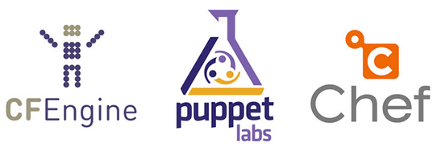



Continuous Delivery Education
Notes:
At this point, you may have shown some good insights about Agile, but chances are, your auditor already knew about it.
CD is a different story. There are LOTS of levels of maturity

Slide 11
Continuous Delivery Education
#7 An Automated Process is far more Auditable!
#8 Correct Version of the Application
great tools to mange environment sprawl
#9 Infrastructure as Code
Environments stay in sync
Environments can be built on demand
Environments are documented and version controlled
#10 Static Code Analysis
#11 Automated Testing
#12 Repository Management
Notes:
37- Going back to the Bible – I can tell you the millisecond that a feature was regression tested
#8 – SNOWFLAKE
#9 - Environments stay in sync – STILL NEED TRIPWIRE
On demand = RECOVERY TIME OBJECTIVE
Environments are documented and version controlled
#10 – Some Security Tests, WhiteHat Sentinal --- KEEP AN EYE ON CHANGE LOG
FIND VULNERABILITIES IN EVERY CHECK IN – Don’t wait for them in Production

Slide 12
Sonar – Tracking Over Time
Notes:
The change in about a year –
KNOWLEDGE IS POWER –
MANAGEMENT OVERSIGHT
GIVE THE TEAM THE INFORMATION THEY NEED

Slide 13
Continuous Delivery Education
#7 An Automated Process is far more Auditable!
#8 Correct Version of the Application
great tools to mange environment sprawl
#9 Infrastructure as Code
Environments stay in sync
Environments can be built on demand
Environments are documented and version controlled
#10 Static Code Analysis
#11 Automated Testing
#12 Repository Management
Notes:
#10 – Some Security Tests, WhiteHat Sentinal --- KEEP AN EYE ON CHANGE LOG
#12 - Single source for software, binaries & libraries demonstrates: -- We use NEXUS

Slide 14
#11 Automated Testing – Unexpected Result
Automated tests are the answer to MANY questions about reducing risk….but they open the door to a whole new world of questions
Who validated that the automated test worked correctly?
How do you know that the test meets the desired result?
How can you be sure you have sufficient coverage?
Where are the tests for specific user stories?
Notes:
RESULTED IN A SURPRISE
WE ARE BACK TO SPREADSHEETS TRACKING THAT OUR UAT TESTS WERE VALIDATED
It is important to show that your pipeline will STOP until any failed automated test is corrected. – SAVE FAILED TEST RUNS

Slide 15
Continuous Delivery Education
#7 An Automated Process is far more Auditable!
#8 Correct Version of the Application
great tools to mange environment sprawl
#9 Infrastructure as Code
Environments stay in sync
Environments can be built on demand
Environments are documented and version controlled
#10 Static Code Analysis
#11 Automated Testing
#12 Repository Management
Notes:
37- Going back to the Bible – I can tell you the millisecond that a feature was regression tested
#8 – SNOWFLAKE
#9 - Environments stay in sync – STILL NEED TRIPWIRE
On demand = RECOVERY TIME OBJECTIVE
Environments are documented and version controlled
#10 – Some Security Tests, WhiteHat Sentinal --- KEEP AN EYE ON CHANGE LOG
#12 - Single source for software, binaries & libraries demonstrates – CONSISTENCY - NEXUS

Slide 16
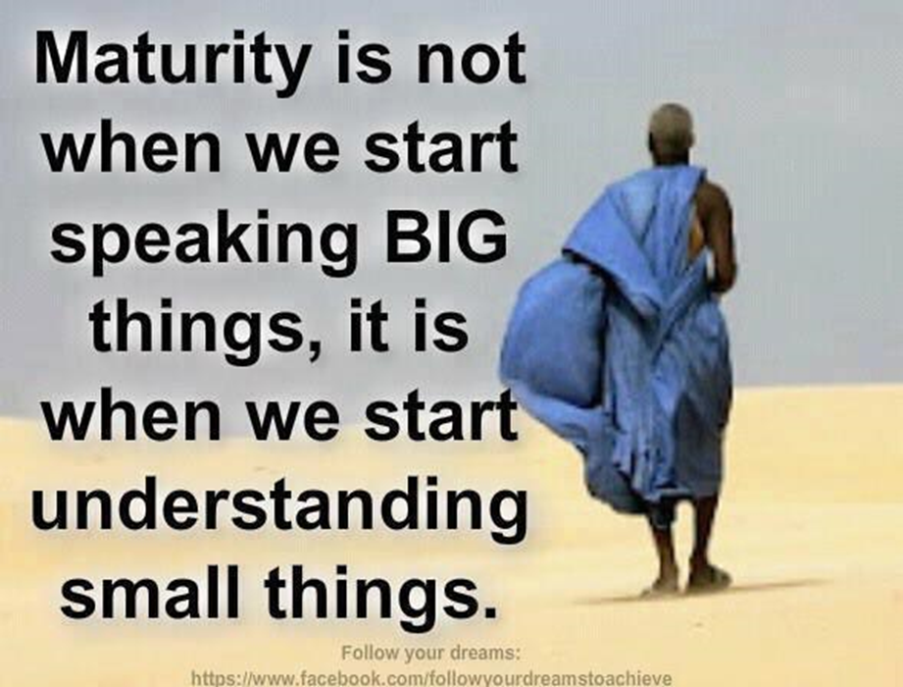
Demonstrating Maturity
Credit: http://ihkstories.com/maturity-is-not-when-we-start-speaking-big-thingsit-is-when-we-start-understanding-small-things/

Slide 17




#13 Go Digital
Online Agile Boards
An Auditor once pulled a sticky off our physical board
that was in the Ready for Test queue. He asked “if I don’t put this back, how do you know this was tested?”
Notes:
Probably one of the more unpopular changes is to switch to an electronic board like Jira. Many teams are very fond of have note cards and post-its on walls, but digital boards are more auditable.
Once you make the switch, you will have lots of unexpected benefits….here are some more!

Slide 18
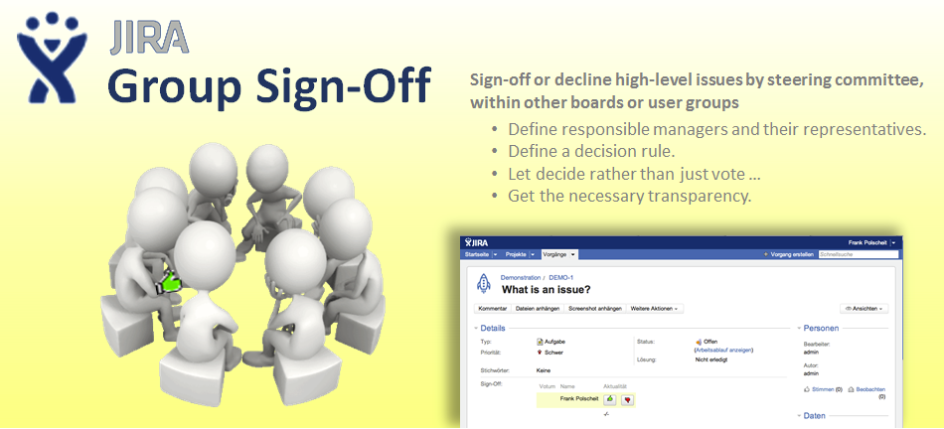
#14 Automating Sign-Offs
Credit: http://www.polscheit.de/plugins/jira/group-sign-off/images/GroupSignOff-Banner.png
Notes:
We use a Jira plugin called Group Sign-Off for Jira. It allows a story to capture key sign-offs from management, security, and compliance.
We include a sign-off story in every sprint and now no longer need to print and get manual signatures.
Using permissions in Jira, I can only sign-off as myself.

Slide 19

#15 Automating Documentation
Credit: http://jiraxporter.xpand it.com/download/attachments/327684/Banner.png?version=1&modificationDate=1364461203281&api=v2
Notes:
This was one of those dreams that I never thought would come true, but with the Xporter Plugin for Jira we are able to perform a mail merge into our SDLC template. We capture the stories and sign-offs for every release to fulfill auditor and examiners requests for documentation.
We do still have the manual step of maintaining master requirements documents for major pieces of functionality.

Slide 20
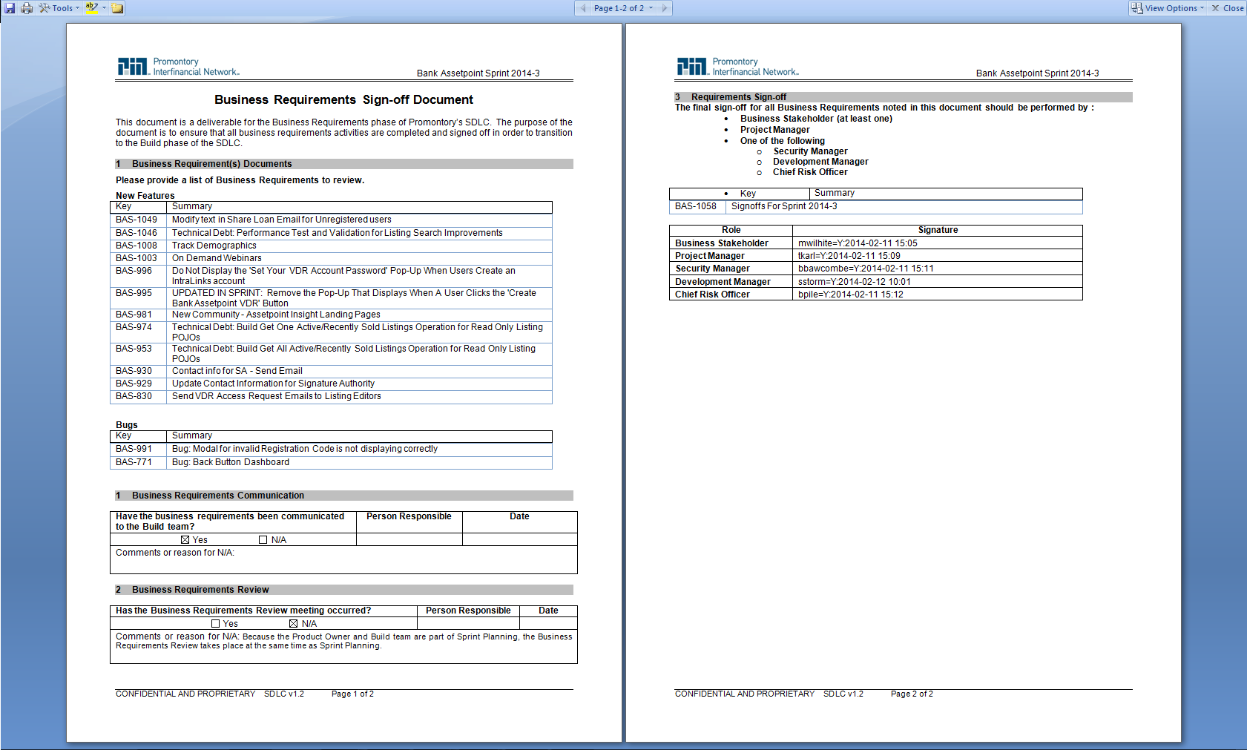
Bank Assetpoint Agile Implementation
Retrieved from Jira
Retrieved from Jira

Slide 21
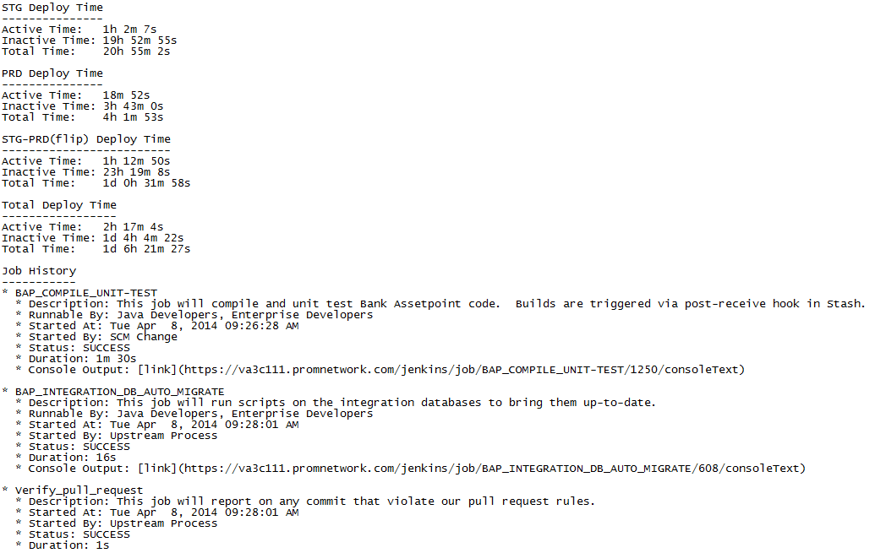
#16 Logging Pipeline Activity
Notes:
Using the logs captured by Jenkins, we created a report to show when each step in the pipeline occurred and who initiated it.
The report is the last step in our Pipeline. It emails a copy of the report to all interested parties and places a copy in Nexus for archival purposes.

Slide 22
#17 Capturing Meaningful Metrics
Notes:
All of the activity logging is beneficial as it shows that all the steps were performed and who performed them. However, they are also rich with information about your own processes.
Graphing the metrics from various points in your development process will again show that management is involved in the process and providing proper oversight.

Slide 23
#18 Add one more meeting
Sprint Planning Review Meeting
Additional demonstration of oversight
Shows that we are willing to adapt to meet company goals
Great catch-all for interested stakeholders
Notes:
With a self managing team that is making small changes every two weeks, it is easy for management to not know exactly what is going on.
We added a Sprint Planning Review Meeting after every sprint planning session. This was facilitated by our ScrumMaster and was found to be very helpful to bring Security, Compliance and anyone else into the process.
Not only was this meeting helpful, but it also demonstrated to auditors and examiners that we were thoughtful about the process and made improvements when needed.

Slide 24
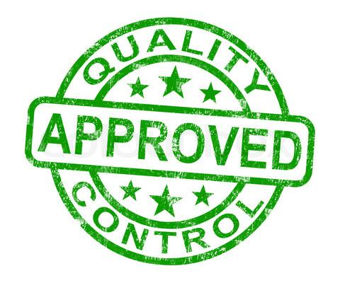
Orchestrate for Improved Quality
Credit: http://accupackmidwest.com/quality-control

Slide 25
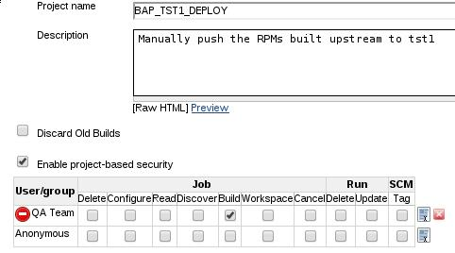
#19 Keep QA Firmly in the Process
When new code comes into Test Environment
When new code can be moved to a higher environment
Perform the deployment to the Staging Environment
Perform the deployment to Production Environment
Notes:
ACTIVE DIRECTORY - NEED TO HAVE A PERIODIC REVIEW OF WHO IS IN GROUPS
Our QA Team performs and important check to ensure that a quality product is deployed. They are also a critical team to maintaining separation of duties. They don’t write the code and they also have the best understanding of how the applications should work. We found they were best suited to facilitate the deployment. They control:

Slide 26
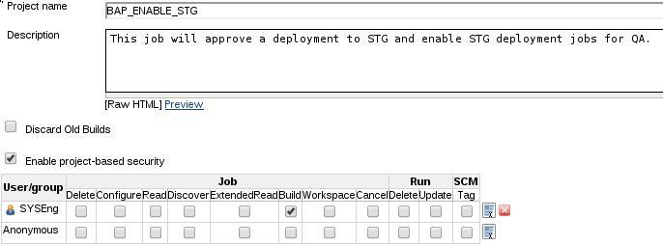
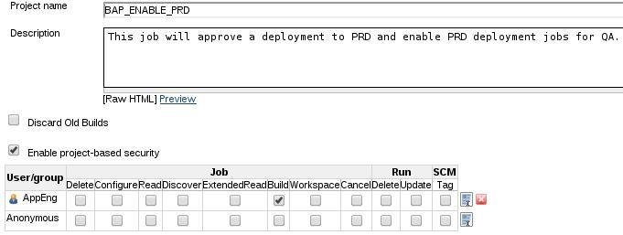
#20 Don’t Forget Operations
The System Engineering Team to controls when code can enter the Staging Environment
Application Engineering Team controls when code can enter the Production Environment
Notes:
QUESTION WAS MADE ABOUT SEPARTION OF DUTIES
RESPONSE THAT GUIDELINES DO NOT SPECIFY THAT IT IS NEEDED
COMPENSATING CONTROLS

Slide 27

#21 When All Else Fails – Email!
Email notifications keep parties informed
Security
Compliance
Management
Operations
Product Owner
Notes:
The rapid deployments still resulted in the occasional incident where someone was caught off guard. We addressed this by adding an email step before Staging and before Production to notify all interested parties that a deployment was coming through.

Slide 28



Source Code Control is KEY

Slide 29



#22 Demonstrate Permissions
Making sure that the appropriate controls are in place in GIT are critical.
You will need to use a management tool on top of GIT like Stash.

Slide 30
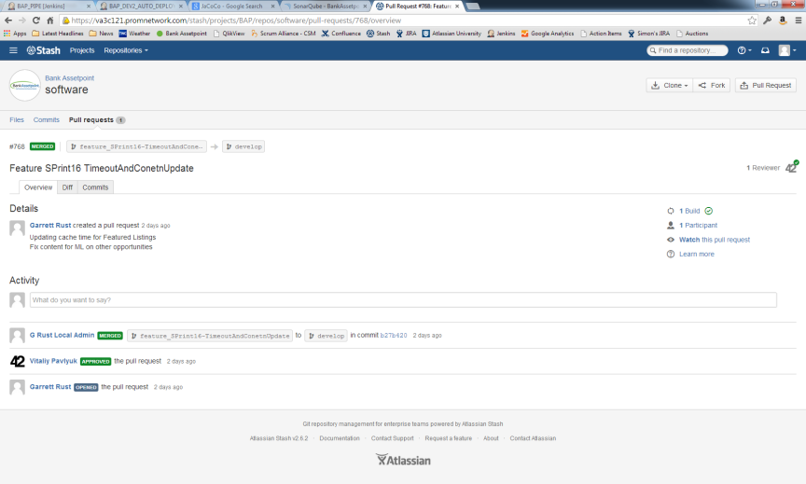
#23 Code Reviews with Pull Requests
Notes:
Only a select number of senior developers and architects have the ability to merge code into the development branch

Slide 31

#24 Secure Your Pull Requests
Custom GIT Hook
Notes:
Users ended up with Local Admin and Regular User
Local Admin users are only allowed to MERGE - by policy
Wrote custom code to only allow ACTIVE DIRECTORY USERS to check in and approve PULL REQUESTS

Slide 32

Getting Ahead
Credit: https://dzihxiql01vk4.cloudfront.net/wp-content/uploads/2013/06/Get-Ahead-with-Repricing.jpg

Slide 33
#25 Be Aware of Outstanding Audit Risks
Get Ahead of Permission Questions
Jenkins, Puppet, Nexus, Stash, etc.
Using Active Directory to manage permissions is a good start, but who is reviewing Active Directory?
Continuous Improvement means that you are not following the same process over and over
Allowing Agile Teams to change their development process to make themselves more efficient is scary to auditors
Notes:
POWER OF A JENKINS USER
POWER OF A PUPPET USER – STILL A GAP –
-- Ansible Tower has done some nice work that will hopefully push all the vendors forward
AGILE TEAMS NEED TO POST THEIR DEFINITIONS OF DONE IN CONFLUENCE (WIKI)
REGULARLY AUDIT USER LISTS - ACTIVE DIRECTORY -
In a recent exam, I was very impressed how quickly the examiner recognized the power of some of the tools like GIT, Stash, Jenkins and Puppet. He immediately wanted to know how we ensure that the appropriate permissions are in place.
Also, think through how you will manage the environment of CD tools. Typically, one doesn’t have a migration path for making changes to Jenkins, Sonar, etc.

Slide 34
Here's what I would like help with
How do you ensure (and regularly audit) that the appropriate people have the appropriate access to the appropriate tools?
How to do you empower individuals but still ensure you have management oversight?

Slide 35

Questions?
Thank you!
Simon Storm
sstorm@promnetwork.com
@simonpstorm
www.linkedin.com/pub/simon-storm/0/b32/3b6/

